Slide 1
Analyze the nucleotide composition (GC content, AT ratio, etc.)
By Gopalakrishnan Kumar, MTech IIT-Bombay,
Certified Data Science Consultant, GLV Data Solutions.
https://www.linkedin.com/in/gopalakrishnankumar-a73301110/
https://www.github.com/Gopalakrishnan-Kumar/
https://www.kaggle.com/gopalkk2

Slide 2
Google Colab URL
https://colab.research.google.com/drive/12oYPh43ef_2DHgzFeyyjcaR3H2LO3X0s?usp=sharing

Slide 3
Objective
To analyze the nucleotide makeup of DNA sequences provided in FASTA format. This includes:
Counting each nucleotide base (A, T, G, C)
Calculating GC and AT content percentages
Determining the AT/GC ratio
Interpreting the genomic characteristics based on base composition

Slide 4
Input
File Name: sequence.fasta Format: FASTA Content: Multiple DNA sequences

Slide 5
Methods Used
a. Parsing Sequences
Using Biopython to read sequences from the FASTA file.
b. Nucleotide Counting
Total counts of A, T, G, and C per sequence.
c. Percentage Calculation
GC Content (%) = (G+C)/Total(G + C) / Total(G+C)/Total × 100
AT Content (%) = (A+T)/Total(A + T) / Total(A+T)/Total × 100
AT/GC Ratio = (A+T)/(G+C)(A + T) / (G + C)(A+T)/(G+C)
d. Data Visualization
Bar chart of GC content per sequence.

Slide 6
Results Summary
 | ID | Length | A | T | G | C | GC_Content(%) | AT_Content(%) | AT/GC_Ratio
0 | lcl|NC_060956.1_cds_XP_046838653.1_1 | 1086 | 385 | 333 | 211 | 157 | 33.88581952 | 66.11418048 | 1.951086957
1 | lcl|NC_060956.1_cds_XP_046838654.1_2 | 1029 | 364 | 312 | 202 | 151 | 34.30515063 | 65.69484937 | 1.915014164
2 | lcl|NC_060956.1_cds_XP_046838655.1_3 | 1029 | 364 | 312 | 202 | 151 | 34.30515063 | 65.69484937 | 1.915014164
3 | lcl|NC_060956.1_cds_XP_046838656.1_4 | 1029 | 364 | 312 | 202 | 151 | 34.30515063 | 65.69484937 | 1.915014164

Slide 7
Interpretation
All sequences had AT and GC content, which implies genomic regions.
AT/GC Ratio indicates bias towards AT-rich sequences.
In biological terms:
AT-rich sequences often indicate structural elements like origins of replication.

Slide 8
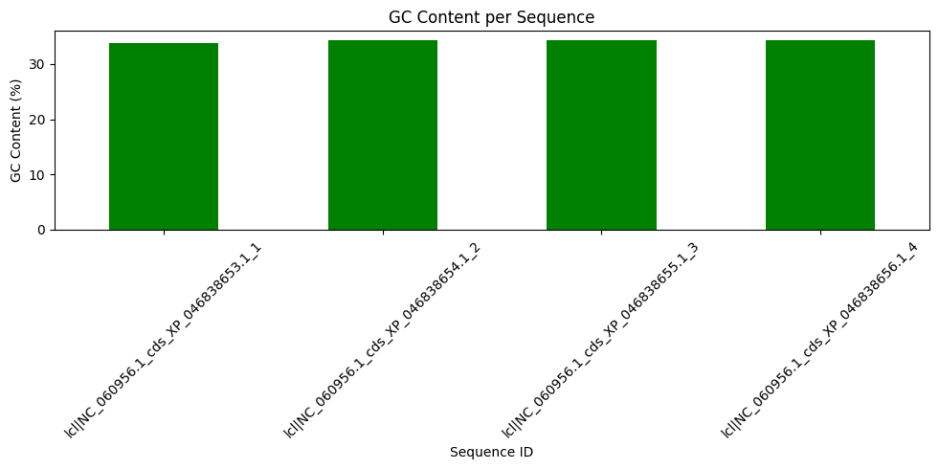
Visualization

Slide 9
Visualization
A bar chart was generated showing GC content for each sequence. This helps identify:
Sequence diversity
Genomic balance or skew
Targets for further study in gene regulation

Slide 10
Conclusion
This analysis provides foundational insights into the genomic composition of DNA sequences. GC and AT content are vital for:
Understanding thermodynamic stability of DNA
Predicting gene regions
Designing primers and probes

